Slide 1
Transmission Mediums in Computer Networks
Unit three

Slide 2
What is transmission medium?
a transmission medium is a physical path between the transmitter and the receiver i.e. it is the channel through which data is sent from one place to another.

Slide 3
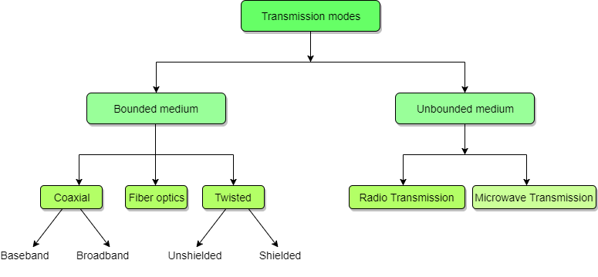
Types of transmission medium

Slide 4
Guided or Bounded Media
It is defined as the physical medium through which the signals are transmitted. It is also known as Bounded media.
Types Of Guided media:
Twisted pair: Twisted pair is a physical media made up of a pair of cables twisted with each other.
Coaxial Cable
Coaxial cable is very commonly used transmission media, for example, TV wire is usually a coaxial cable.
Fiber Optic
Fibre optic is a cable that holds the optical fibres coated in plastic that are used to send the data by pulses of light.

Slide 5
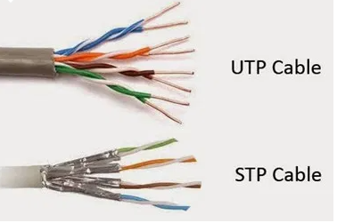
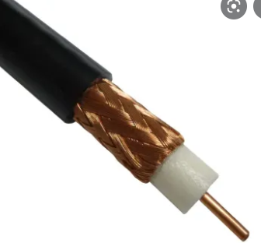
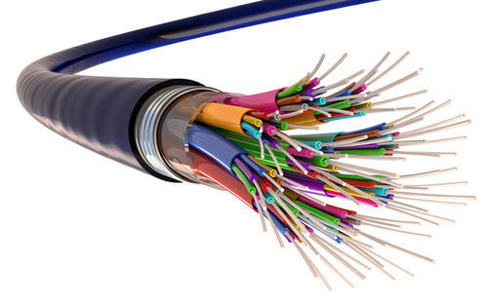
Twisted Pair Cable Coaxial cable
Fiber optic able

Slide 6
Unguided or Unbounded
An unguided transmission transmits the electromagnetic waves without using any physical medium. Therefore it is also known as wireless transmission.
In unguided media, air is the media through which the electromagnetic energy can flow easily.

Slide 7
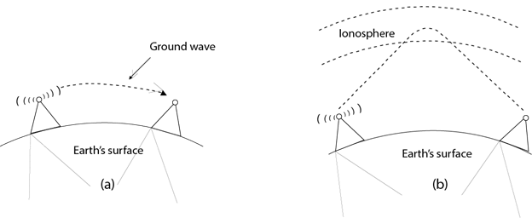
Radio Waves
Radio waves are the electromagnetic waves that are transmitted in all the directions of free space.
Radio waves are omnidirectional, i.e., the signals are propagated in all the directions.
The range in frequencies of radio waves is from 3Khz to 1 khz.
In the case of radio waves, the sending and receiving antenna are not aligned, i.e., the wave sent by the sending antenna can be received by any receiving antenna.
An example of the radio wave is FM radio.

Slide 8
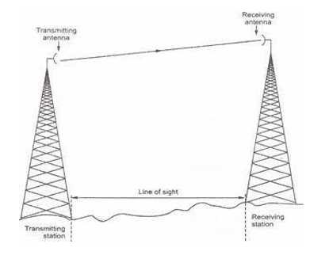
Microwaves
Micro Waves includes a line of sight transmission that is the sending and receiving antennas that need to be properly aligned with each other. The distance is directly proportional to the height of the antenna which is covered by the signal. In mobile phone communication and television distribution, these are majorly used.

Slide 9
Infrared
An infrared transmission is a wireless technology used for communication over short ranges.
It is used for short-range communication such as data transfer between two cell phones, TV remote operation, data transfer between a computer and cell phone resides in the same closed area.

